Slide 1
Objectives
In this session, you will:
  Appreciate the importance of conversation
  Identify the constituents of a good conversation
  Understand the techniques to enhance your conversation
  Describe the non-verbal cues in a conversation
  Identify cultural differences
  Understand the importance of avoiding slang
Notes:
Rationale: As long as we are in this world, we will have conversations with people. Just like breathing, conversation is an indispensable part of our lives. Conversations are very subtle and they occur pretty fast. We can all think of conversations that have gone wrong at work, home, or some other place. Conversation is a life skill and we are expected to master this art as we go along.

Slide 2
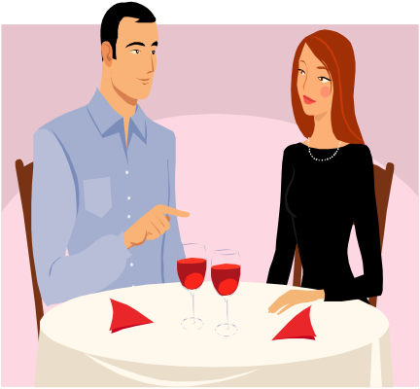

Conversation: The Heart of Communication
Conversation is the most important means of communication.
Conversations builds relationships with our colleagues, customers, and friends.
Conversation links people together in the social and professional life.
Notes:
You can ask the students to recall the ice breaking session conducted earlier and how the students became acquainted with each other through conversation.

Slide 3

Activity: Analyzing Conversation Habits
In this activity, you will learn to analyze your own conversation habits.

Slide 4

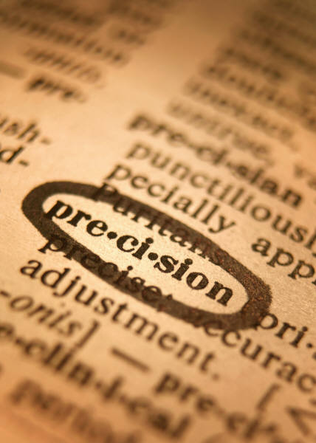
Constituents of a Good Conversation
Face-to-face conversation should be clear and effective.
The essential ingredients of a good conversation are:
  Clarity
  Brevity
  No verbosity
  Sequence
  Precision
Notes:
Emphasize on each element of a good conversation. Relate to previous activities.

Slide 5




Techniques to Improve Conversation
The techniques that can be used to enhance your conversation style are:
  Audibility of voice
  Level of interest
  Friendly atmosphere
  Sense of humor
  Use of visuals
Notes:
For example, if a high-profile celebrity makes use of words and phrases that are objectionable, then it can severely damage his/her image in the public.

Slide 6
Non-verbal Cues in a Conversation
Conversations are not merely an exchange of words.
Conversations go wrong because you misinterpret
non-verbal messages.
Non-verbal cues are categorized into the following elements:
  Body language
  Gestures
  Facial expression
  Eye contact
  Space distancing

Slide 7

Body Language
Body language is the most powerful language.
Body language signals are called leakages.
The negative leakages that you should avoid during a conversation are:
  Crossed arms or legs
  Tapping foot
  Biting nails
  Fiddling with hair
  Scratching your face
Notes:
Think of your own posture while you are reading this statement. If you are sitting in a relaxed position, it implies that you are interested in the subject. Body language communicates much more than words. If you work on your body language by finding out what your unsaid words communicate, you can considerably improve your conversation. You should be aware of how certain postures and body language are usually perceived by others.

Slide 8
Gestures
Gestures play a significant role in making the conversation effective.
Gestures are expressed with the movement of body parts especially associated with hands.

Slide 9


Facial Expression
The face is the most expressive part of the body.
Some of the facial expressions and their implied meanings are:
  Smile: Friendliness
  Frown: Discontent
  Raising the eyebrows: Disbelief
  Tightening the jaw muscles: Dislike and hostility

Slide 10

Eye Contact
Eye contact is one of the most powerful tools that you possess during a conversation.
Notes:
Emphasize the fact that while conversing, eye contact has to be used in moderation since excess of everything is bad.

Slide 11

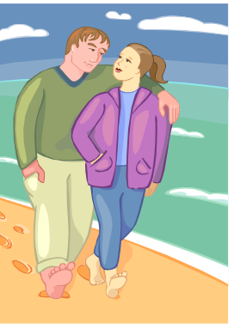
Distance Spacing
When you go out in the world, you move within four distance bands:
  Public
  Social
  Friendly
  Intimate
Notes:
During a conversation, invade another person’s intimate space, if and only if you are completely sure that it is appropriate.

Slide 12

Identifying Cultural Differences
People from different cultures, have different ways of perspectives on life, dressing, and communicating.
Miscommunication occurs due to cross-cultural differences.
Primarily, miscommunication occurs due to differences in:
  Body language or gestures.
  Meanings for the same word.
  Assumptions made in the same situation.
Notes:
Ask the students “How do we greet people in England?”. Once the students share their answer “By shaking hands”, ask again “How do people greet in Japan?”. Share that in Japan people bow each other to greet. Then, explain the types of miscommunication that can occur in cross-cultural communication. Therefore, conclude by saying that they need to appreciate cultural differences and handle every customer equally irrespective of their cultural differences.

Slide 13

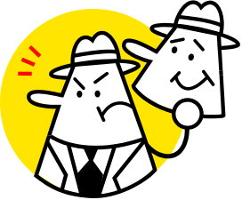
Slang
Slang:
  Is an informal language.
  Is inappropriate for formal communication.
Slang projects an unprofessional image in any conversation.
Notes:
Discuss with the students that they need to avoid slang and informal conversation in professional environment.
You can also share following example:
ain’t:
Nonexample:
I ain’t seen her since last month.
Example:
I have not seen her since last month.

Slide 14
Activity: Identifying Slang
Identify the slang from the following sentences:
  The printer that I purchased from your shop is nothing but a piece of crap.
  No matter how many mistake she makes, she will say it ain’t my fault.
  After listening to her story, I am in a fix.
  I was supposed to provide technical assistance but I screwed it up.
  I don’t give a damn because it is none of my business.

Slide 15
Activity: Identifying Slang (Contd.)
Solutions:
  The printer that I purchased from your shop is nothing but a piece of crap.
  No matter how many mistake she makes, she will say it ain’t my fault.
  After listening to her story, I am in a fix.
  I was supposed to provide technical assistance but I screwed it up.
  I don’t give a damn because it is none of my business.

Slide 16
Summary
In this session, you learned that:
  Conversation is the most important means of communication.
  The essential ingredients of a good conversation are:
    Clarity
    Brevity
    No verbosity
    Sequence
    Precision
Notes:
Use this slide and the following slides to summarize the key concepts of the session to the students.

Slide 17
Summary (Contd.)
  The techniques that can be used to enhance your conversation style are:
    Audibility of voice
    Level of interest
    Friendly atmosphere
    Sense of humor
    Use of visuals
  Non-verbal cues are categorized into the following elements:
    Body language
    Gestures
    Facial expression
    Eye contact
    Space distancing

Slide 18
Summary (Contd.)
  Body language is the most powerful language.
  Gestures are usually associated with the movement of body parts especially associated with hands.
  The face is the most expressive part of the body.
  Eye contact is one of the most powerful tools that you possess during a conversation.
  When you go out in the world, you move within four distance bands:
    Public
    Social
    Friendly
    Intimate

Slide 19
Summary (Contd.)
  Miscommunication occurs due to cross-cultural differences.
  Primarily, miscommunication occurs due to differences in:
    Body language or gestures.
    Meanings for the same word.
    Assumptions made in the same situation.
  Slang:
    Is an informal language.
    Is inappropriate for formal communication.

